Slide 1
Case Law After Bosman
Christelle Deliège v.Ligue Francophone de Judo et others (C-51/96 and C-191/97), 11 April 2000
Sports Rules on selecting Athletes as long as are inherent to the organization of a competition are in compliance with Art. 56 TFEU (freedom to provide services).
.
1

Slide 2
Case Law After Bosman
Jury Lehtonen and others v. Fédération Royale Belge des Sociétés de Basketball (C-176/96), Judgement of 13 April 2000
Transfer windows may be an obstacle to the freedom of movement but …
They can be justified in view of preserving the integrity of sports competition
2

Slide 3
Basic Principles of Union Law
EU law applies to Sport in so far it constitutes an economic activity (ECJ case law)
No Activities “purely” social, artistic or sporting ......
but then “MECA MEDICA” judgement of 18 July 2006...
Test of “Necessity”
Test of “Proportionality”

Slide 4
MECA MEDINA – MADJEN Case C-519/04 P (18 July 2006)

Slide 5
DOPING: Two swimmers tested positive
Sports track
FINA Sanction (4 years Ban)
CAS sanction ( 2 years Ban)
Ordinary EU Track
EU Commission (no competent)
General Court (no competent)
Court of Justice (competent)

Slide 6
Are Sporting Rules (doping) subject to EU Law ?
No assessment in abstract.
Account must be taken of a:
“the overall context” in which the decision of the association of undertakings was taken or produces its effects.
Its objectives: measures inherent in the pursuit of those objectives and proportionate to them.
Proportionality of measures (quid sportive sanctions?)

Slide 7
FINDING OF THE COURT
IOC = association of undertakings (NOCS)
OVERALL CONTEXT : Doping rules have a legitimate objective (fight against doping – fair play – protection of the athletes’ health)
NEVERTHELESS sanctions must be proportionate to the (sports) offence committed

Slide 8
Specificity of Sport
NO BLANKET EXEMPTION from EU competition law
All rules on authorizations of third-party events must be based on objective, transparent,non discriminatory criteria
Sanctions must be proportionate (MECA –Medina test).

Slide 9
The White Paper on Sport (2007)
4.1. SPECIFICITY OF SPORT
Sport activity is subject to the application of EU law.
At the same time, sport has certain specific characteristics, which are often referred to as the "specificity of sport"

Slide 10
The White Paper on Sport (2007)
4.1. Organizazion of Sport
The political debate on sport in Europe often attributes considerable importance to the so-called "European Sport Model".
The Commission considers that certain values and traditions of European sport should be promoted. In view of the diversity and complexities of European sport structures it considers, however, that it is unrealistic to try to define a unified model of organisation of sport in Europe.
Moreover, economic and social developments that are common to the majority of the Member States (increasing commercialisation, challenges to public spending, increasing numbers of participants and stagnation in the number of voluntary workers) have resulted in new challenges for the organisation of sport in Europe.

Slide 11
ART. 6 TFEU (2007) entry into force (2009)
The Union shall have competence to carry out actions to support, coordinate or supplement the actions of the Member States. The areas of such action shall, at European level, be:
-
(e) education, vocational training, youth and sport.

Slide 12
ART. 165 TFEU (2007)entry into force (2009)
“The Union shall contribute to the promotion of European sporting issues while taking account of its specific nature, its structures based on voluntary activity and its social and educational function”. (art. 165 TFEU, para. 1)
Union Action shall be aimed at : …
developing the European dimension in sport,
by promoting fairness and openness in sporting competitions and cooperation between bodies responsible for sports, and by
protecting the physical and moral integrity of sportsmen and sportswomen, especially the youngest sportsmen and sportswomen. (art. 165 TFEU, para. 2)
(Some ideas: the “Erasmus Sports Programme” )
https://www.youtube.com/watch?v=AJ_cujtx1Dw
European Parliament : 10 October 2010

Slide 13
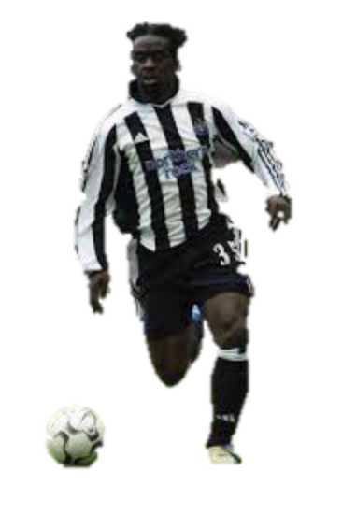
Olympique Lyonnais v. Olivier Bernard and Newcastle UFC Case C-325/08 (Judgement of 16 March 2010)
.
French Player of Olympique Lyonnais (French Club)
End of 3 years contract as a “talented young player”
Obligation to sign first Professional Contract with Training Club
Newcastle FC (English Club)
Compensation (damages) : 53.357 euros (one year salary)
13

Slide 14
BERNARD CASE
A training Compensation can “be justified by the objective of encouraging the recruitment and training of young players”.
However, such a scheme must be actually capable of attaining that objective and
be proportionate to it,
taking due account of the costs borne by the clubs in training both future professional players and those who will never play professionally (para. 45).

Slide 15
This is only the beginning of a wonderful story
To be continued….

